Slide 1

Introduction to VBA Language and
Programming Structure
BSEN 6250

Slide 2
Visual Basic for Applications
Form of BASIC computer programming language
Sits inside Microsoft Excel and other Microsoft products
Can be used to write programs that interface with Excel
Turned off by default
Go to File>Options>Customize Ribbon to turn on VBA

Slide 3
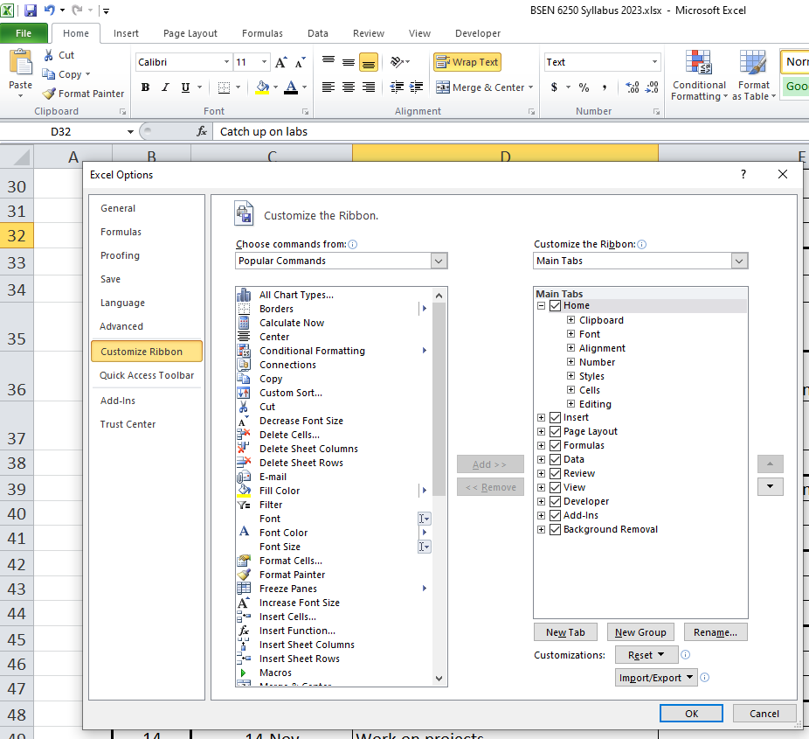
VBA On Developer Tab of Customized Ribbon
Turn on Developer in the Customized Ribbon to activate VBA

Slide 4
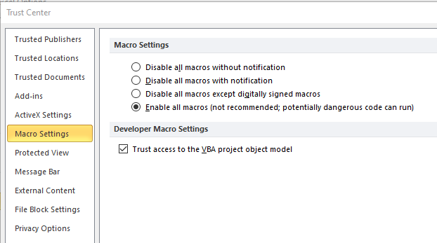
VBA is a Macro in Excel
To Run VBA programs, you must change security settings in Excel
File>Options>Trust Center > Trust Center Settings>Macro Settings
Select “Enable all macros” option
Because VBA is a Macro, you must save your Excel file with an XLSM extension

Slide 5
Give the Program a Name
In VBA, a program is called a subroutine.
Click the Developer tab
Click Visual Basic
Double-Click the Excel worksheet you want to attach the program to
This will open a new blank page that you write the program in
The Sub command tells VBA where the subroutine starts and the End Sub command tells VBA where the subroutine ends.
You can have many different subroutines on this page
Each new subroutine starts with the Sub {name} and ends with End Sub
Type “Sub Water” and press enter to create a subroutine called “Water”

Slide 6
Simple Rainfall Harvesting Tank
Write a VBA program to compute daily height of water in tank
Daily Evaporation, mm
Daily Rainfall, mm
Day of Year | Rain, mm | Depth in Tank, mm
0 |  | 0
1 | 0
2 | 10
3 | 0
4 | 10
5 | 0
6 | 10
7 | 0
8 | 10
9 | 0
10 | 10
11 | 0
12 | 10
13 | 0
14 | 0
15 | 0

Slide 7
Structure of VBA Program
Dimension major variables
Read in model inputs
Set initial value for other variables
Use loops to make time series calculations
Write output back to screen
Add many comments to your code
Define all variables and units using comment statements

Slide 8
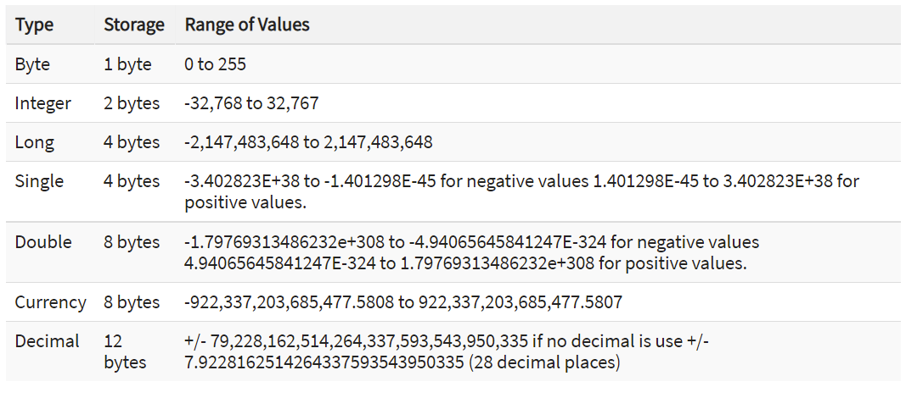
VBA Principles-Dimensioning Variables
Dimension all variables using the DIM command
Dim x, y, z as Double

Slide 9
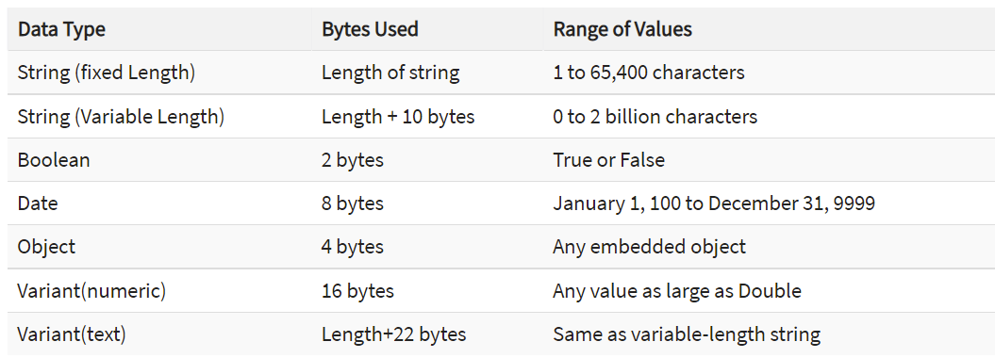
VBA Principles-Dimensioning Variables
Dimension all variables using the DIM command
Dim x, y, z as Integer
Dim Name as String

Slide 10
VBA Principles
Add comments in the code using apostrophe
Use comments to define sections of the code
Add variable list at beginning or end of code
Indent lines of code between For and Next statements
Initialize all variables!

Slide 11
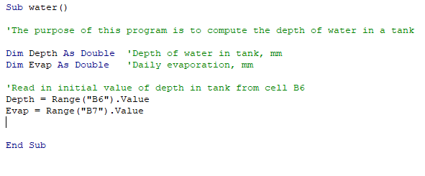
Read in Model Inputs
VBA uses the Range command to read values from Excel and assign them to model variables, and to place model variable values back into excel spreadsheet cells

Slide 12

Debug the Code Step By Step!
There are icons on the ribbon to run the program
Press the “F8” key to step through the code line by line
Move the cursor over each variable to see the values
To terminate the debug, press the Icon
Runs the program without debugging
Stops the program

Slide 13
Create Summation Loop
For Next loops are the most common loop to sum up variables
Loops contain an index that counts through spreadsheet columns
Index can be real or integer
The state variable in this problem is the depth of water in the tank
In this loop, we need to read the daily rainfall, then add it to tank and subtract daily evaporation
We also need to write the depth to the tank back to the spreadsheeet

Slide 14
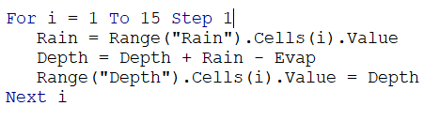
Format of For-Next-Step Loop
Index i is the loop counter
Code between For and Next is implemented 15 times
Index i is incremented by the value of Step
When index i reaches the value of 15, the loop is terminated and program moves on
Step can be integer or real number (ie. 0.1)
This loop conducts depth balance of water in the tank

Slide 15
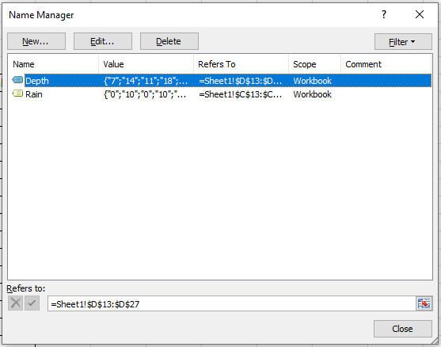
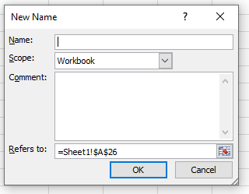
How to Read In Column of Data from Excel into VBA
Define a group of cells in Excel as a “Name”
You can then reference the relative cell location by “Name” rather than traditional cell reference (ie. A1 or B30) in the VBA Range command
The Define Names command is in the >Formulas >Define Name menu option in Excel
The Name Manager in the Formulas tab shows what range of cells have been linked to each defined name

Slide 16
Referring to Cells in a Named Range of Cells
Groups of Cells Defined by “Name” in Excel
How to reference using “Range” command
Rain, mm | Depth in Tank, mm
 | 0
0 | 7
10 | 14
0 | 11
10 | 18
0 | 15
10 | 22
0 | 19
10 | 26
0 | 23
10 | 30
0 | 27
10 | 34
0 | 31
0 | 28
0 | 25
Rain, mm | Depth in Tank, mm
 | 0
Cell(1) | Cell(1)
Cell(2) | Cell(2)
Cell(3) | Cell(3)
Cell(4) | Cell(4)
Cell(5) | Cell(5)
Cell(6) | Cell(6)
Cell(7) | Cell(7)
Cell(8) | Cell(8)
Cell(9) | Cell(9)
Cell(10) | Cell(10)
Cell(11) | Cell(11)
Cell(12) | Cell(12)
Cell(13) | Cell(13)
Cell(14) | Cell(14)
Cell(15) | Cell(15)
Named “Rain”
Named “Depth”
Rain = Range(“Rain”).Cells(2).value
This sets the variable Rain to a value of 2 mm
The index of a For-Next loop can be used to reference a cell in a Named range

Slide 17
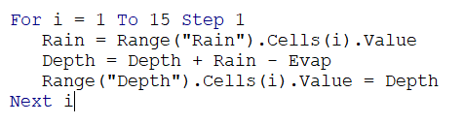
For-Next-Step Loop
Steps through 15 days
Reads in daily rainfall from cells defined as “Rain”
Computes daily depth of water in tank
Outputs daily depth back to spreadsheet in cells defined as “Depth”

Slide 18
Program Logic
Program executes lines of code step by step
Think about logic and sequence of calculations
Read in variables from Excel before they are used
Initialize all variables to 0 or an initial condition before using
If output is daily, output statements need to be in loops
Debug after every new concept/equation is created
Use breakpoints to stop the program and start debugging using F8 key

Slide 19
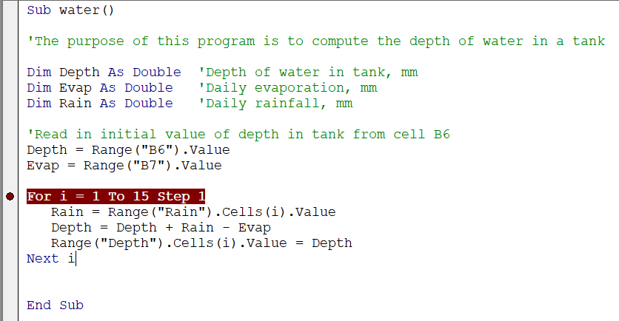
Break Points
A break point stops the program at that line of code to allow you to evaluate variable values at that point
At a breakpoint, you can use the “F8” key to step through the code line by line for debugging the program
Insert a breakpoint by clicking in the grey column in front of the line of code
Click Here

Slide 20
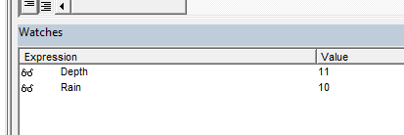
Watch Window
Right click on any variable in the program to “Add to Watch”
Variable shows up at bottom of screen with it’s value
Very helpful when stepping through program and debugging

